Slide 1
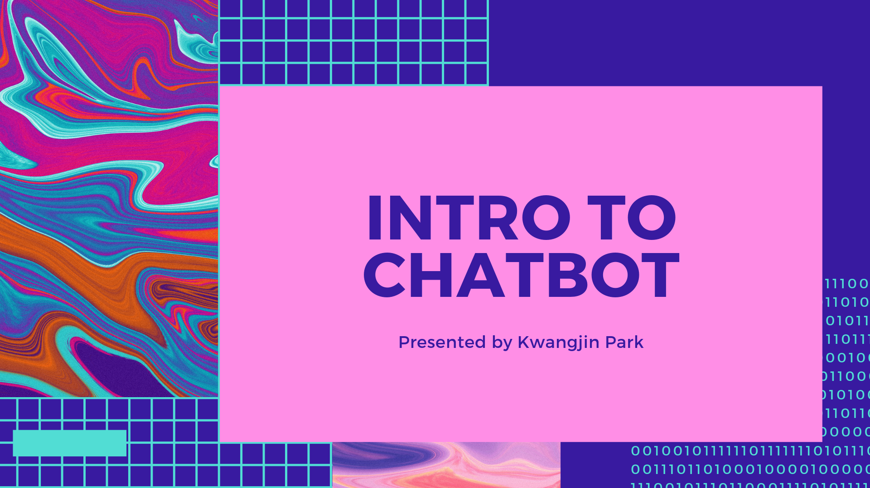

Slide 2
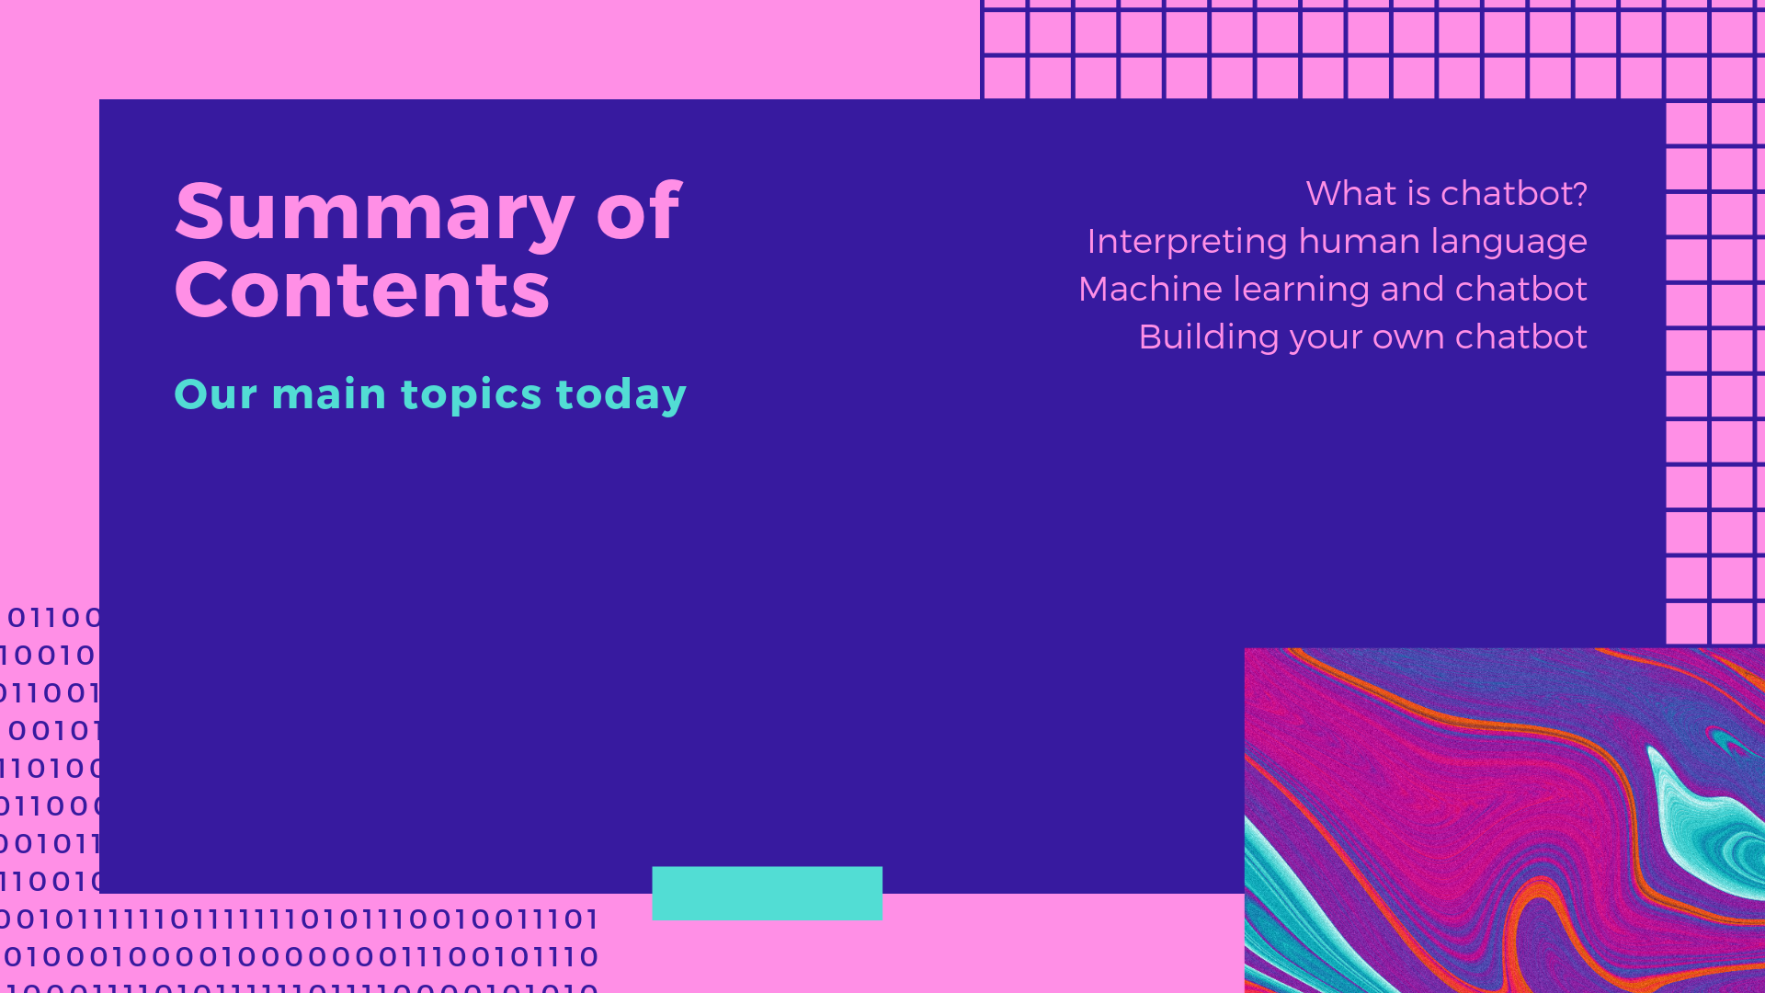

Slide 3
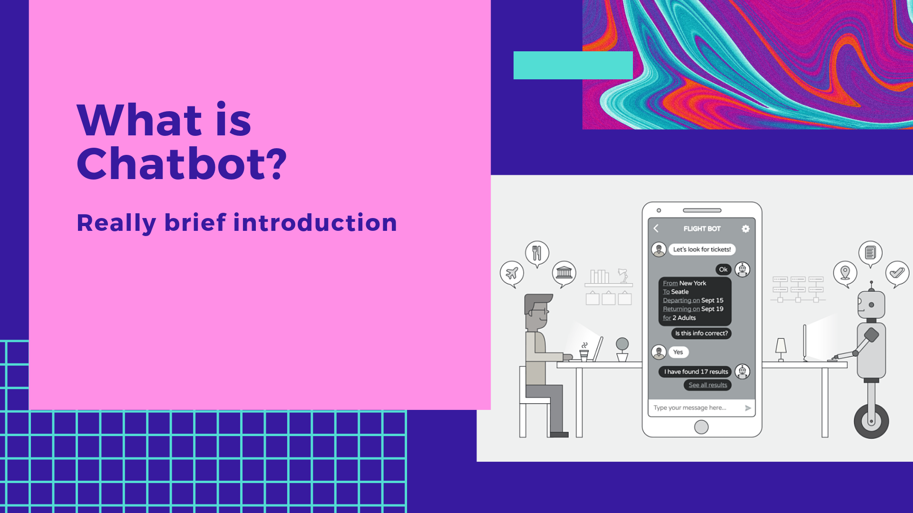
Notes:
Part 1

Slide 4
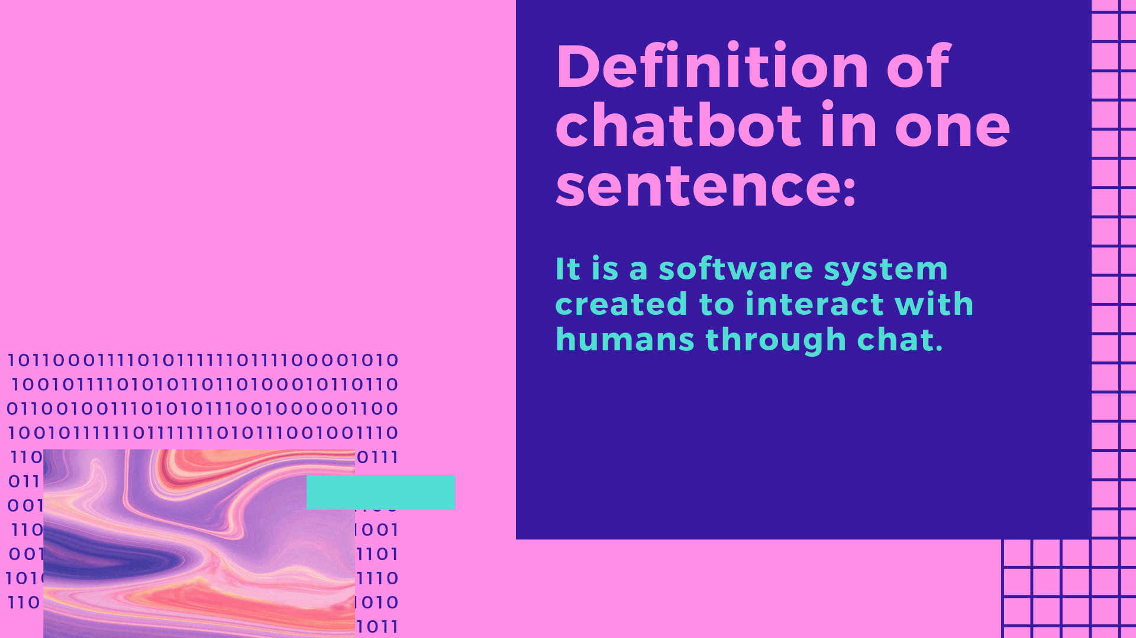
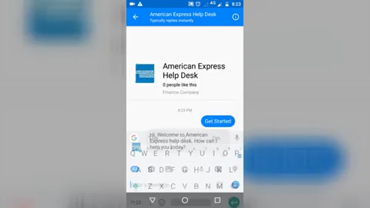

Slide 5
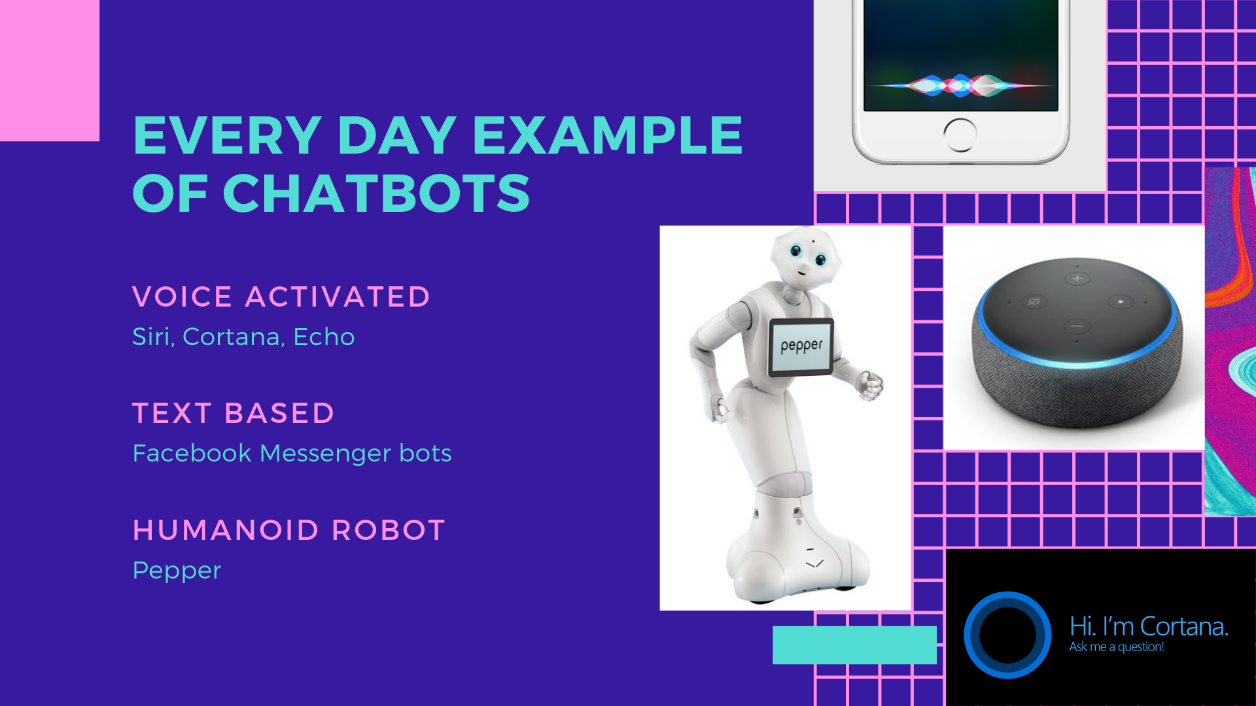
Notes:
You have probably seen chatbot in its various iterations: As AI speakers, message boxes, and humanoid robots. Any software that understands human language and responds appropriately can be identified as chatbots.

Slide 6
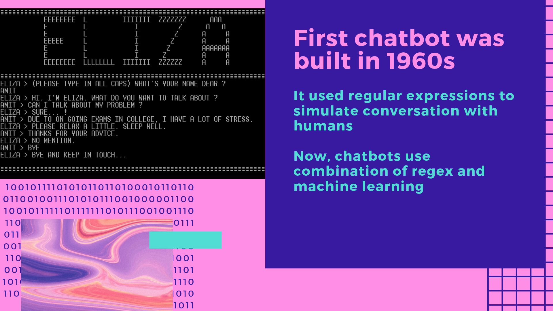
Notes:
This chatbot is even simpler version than eliza.
Do a quick demo using eliza.py.
The code for this chatbot will be available in my github link.

Slide 7
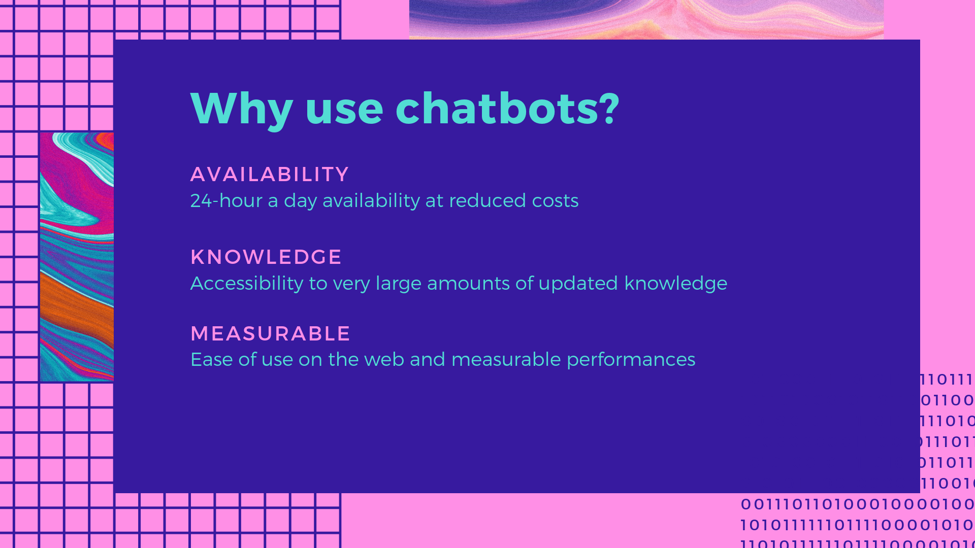

Slide 8
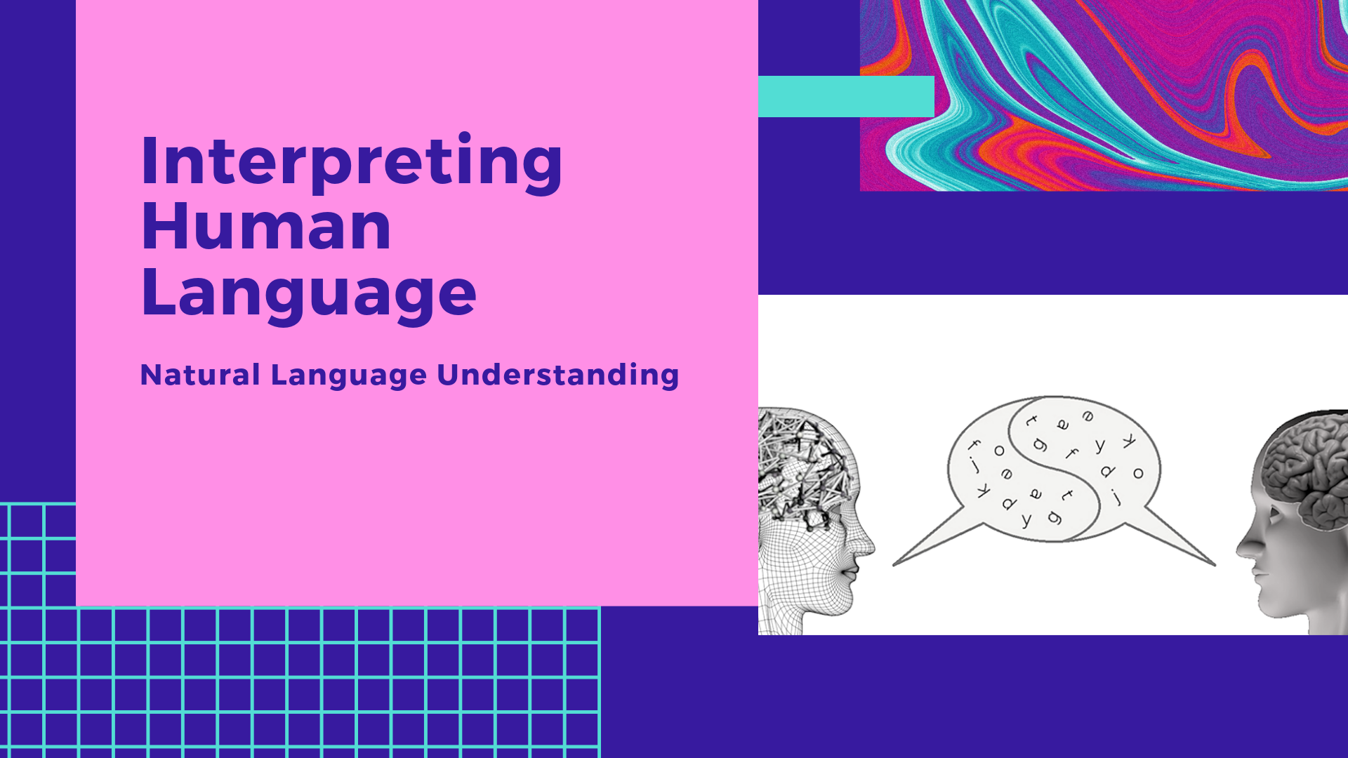
Notes:
Part 2

Slide 9
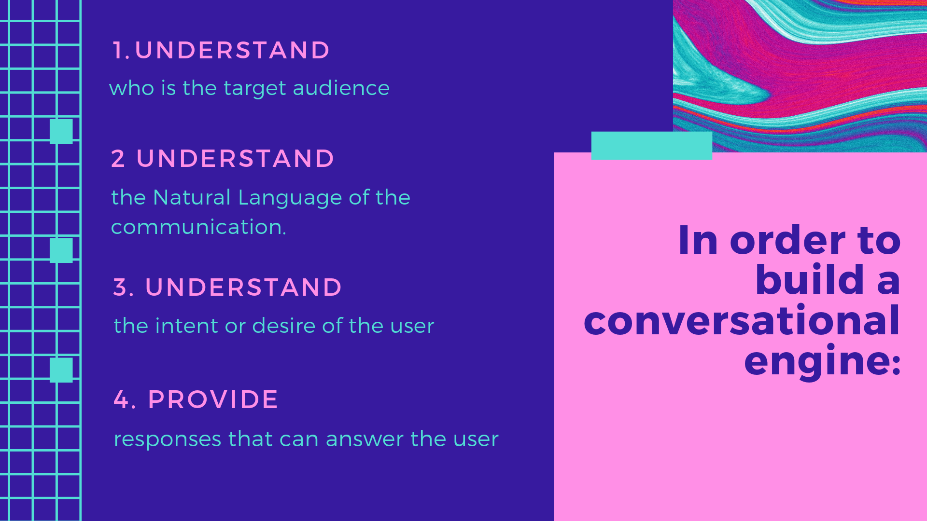
Notes:
First, understand target audience: college students, consumer of the product, businessmen/women, and so on?
Second, understand the natural language of communication: Is the user asking question in English, French, Chinese, Spanish, and so on?
Third, the intent or desire of the user: Is the user asking about book recommendation, restaurant search, booking hotel, how to use software?
Lastly, you want your chatbot provide appropriate response to user’s question

Slide 10
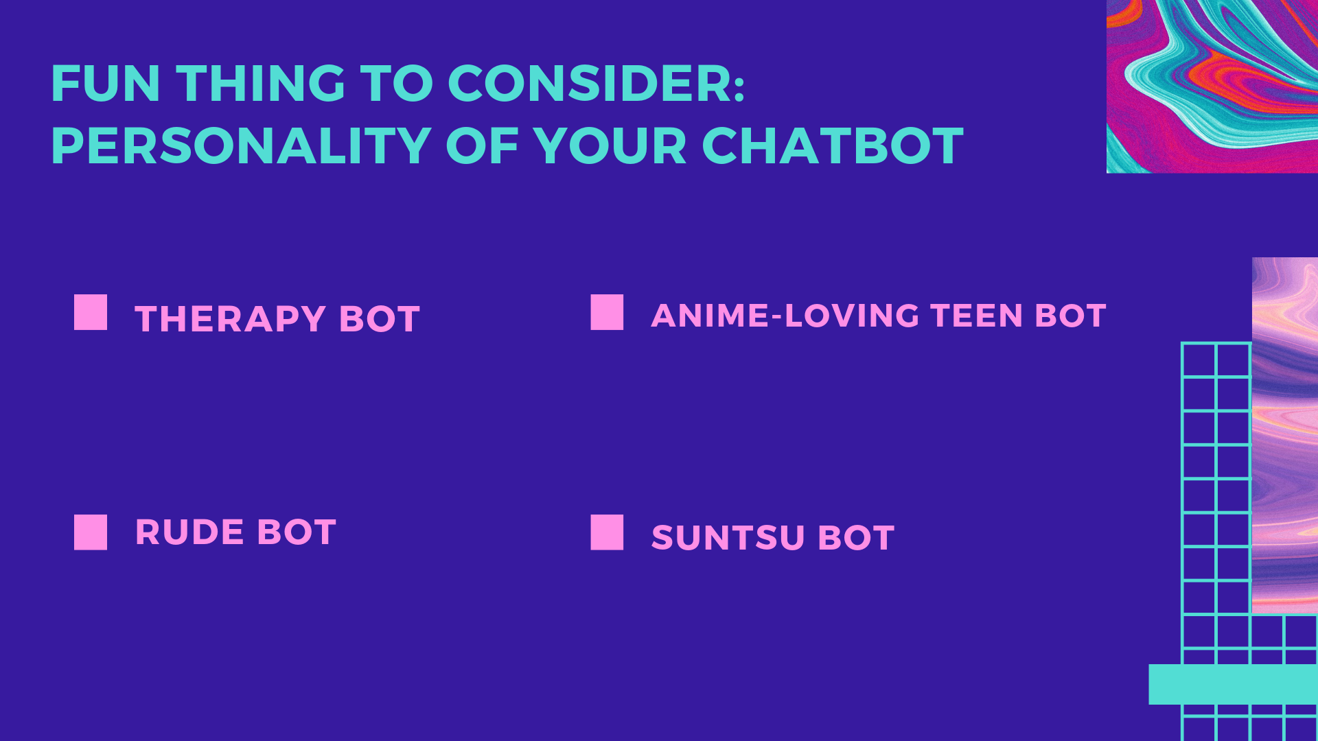
Notes:
Do 2 of demo:
therapybot.py
Teenbot.py
Rudebot.py
Suntsubot.py

Slide 11
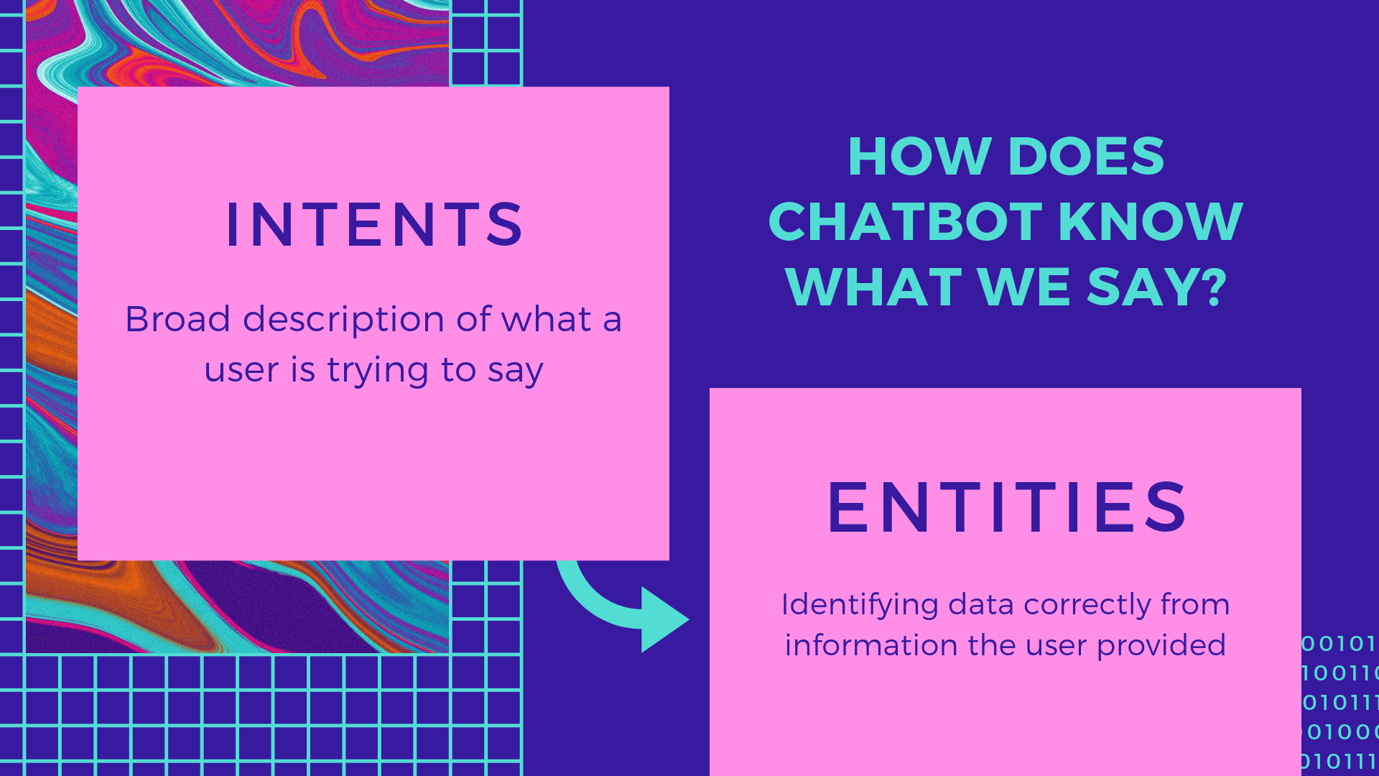
Notes:
Now let’s discuss how a chatbot process human language.
When you type some text into your chatbot, generally it looks for two things: intents and entities of the sentence.
Intent is the broad description of what a user is trying to say and
Entities is data classification from information the user provided

Slide 12
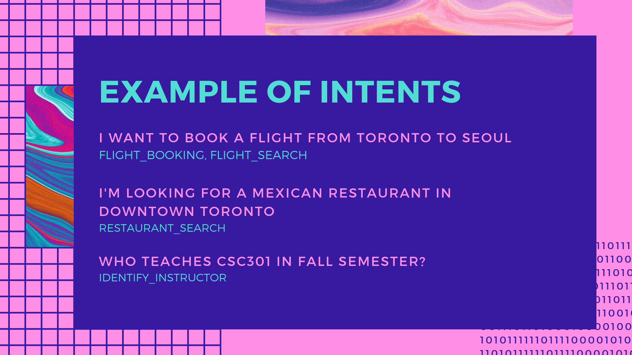

Slide 13
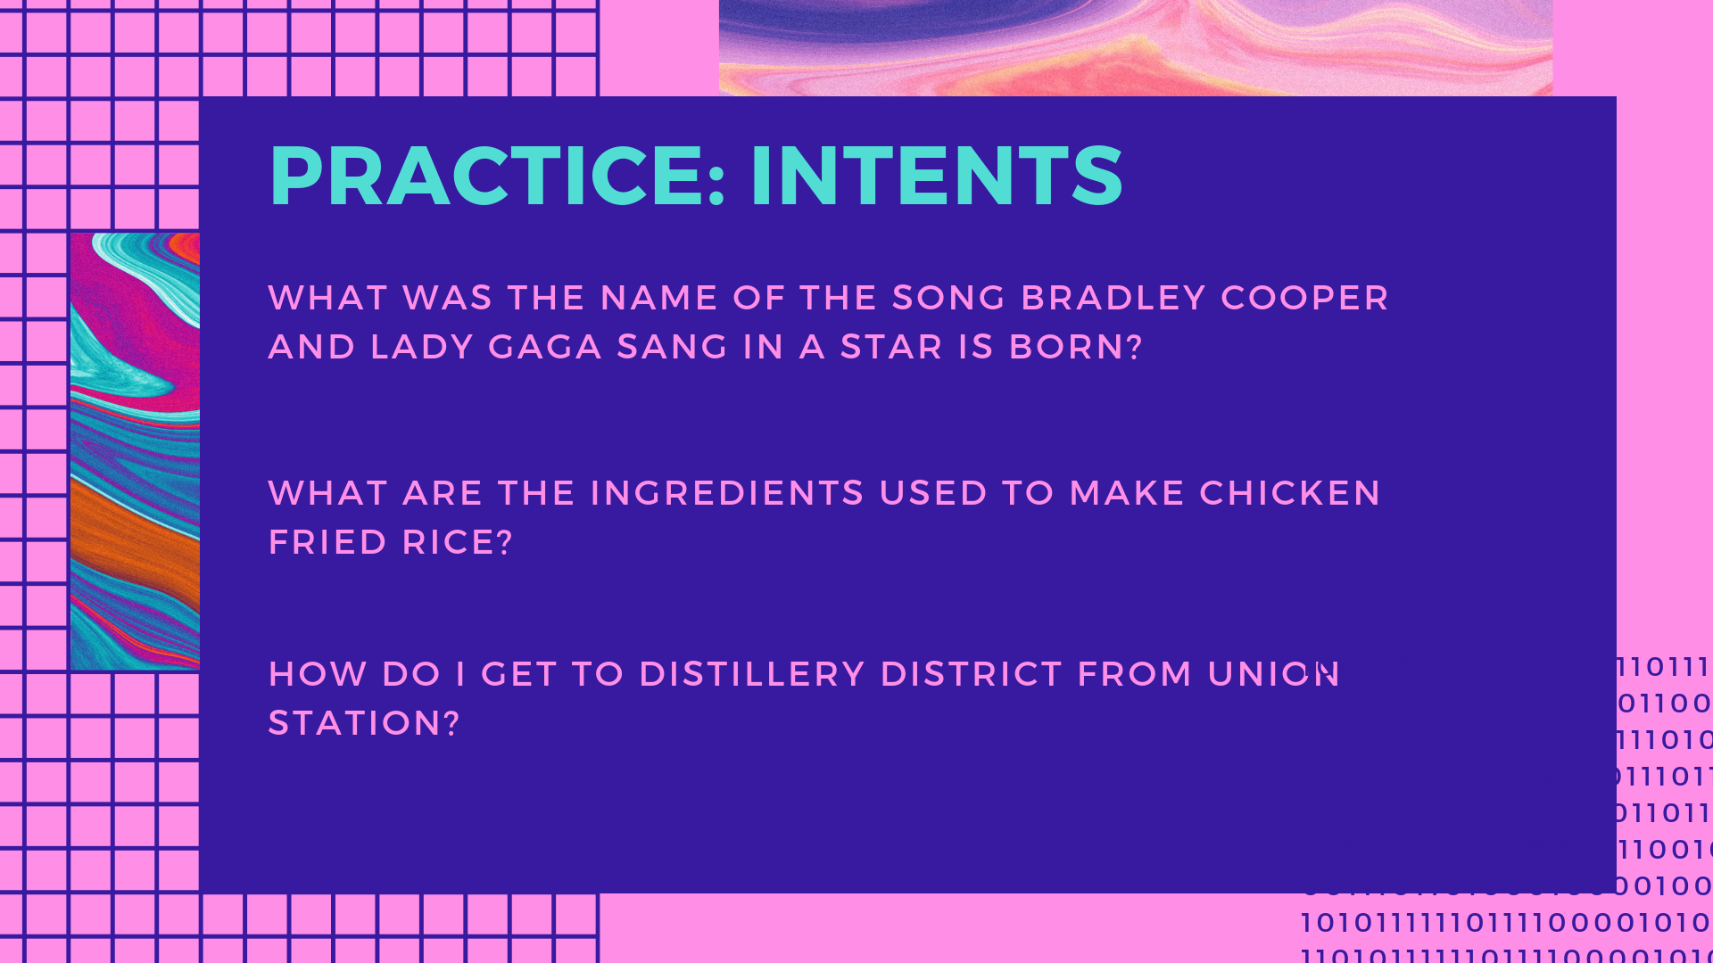
Notes:
There is no one right way to define intents and it is entirely depended on what type of chatbot you are building

Slide 14
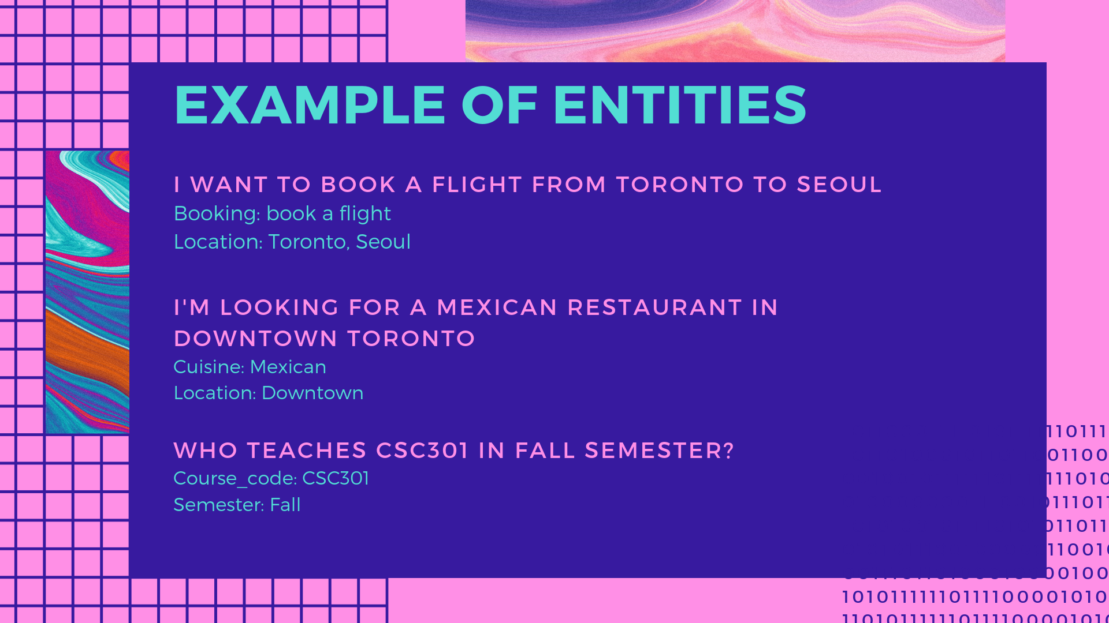

Slide 15
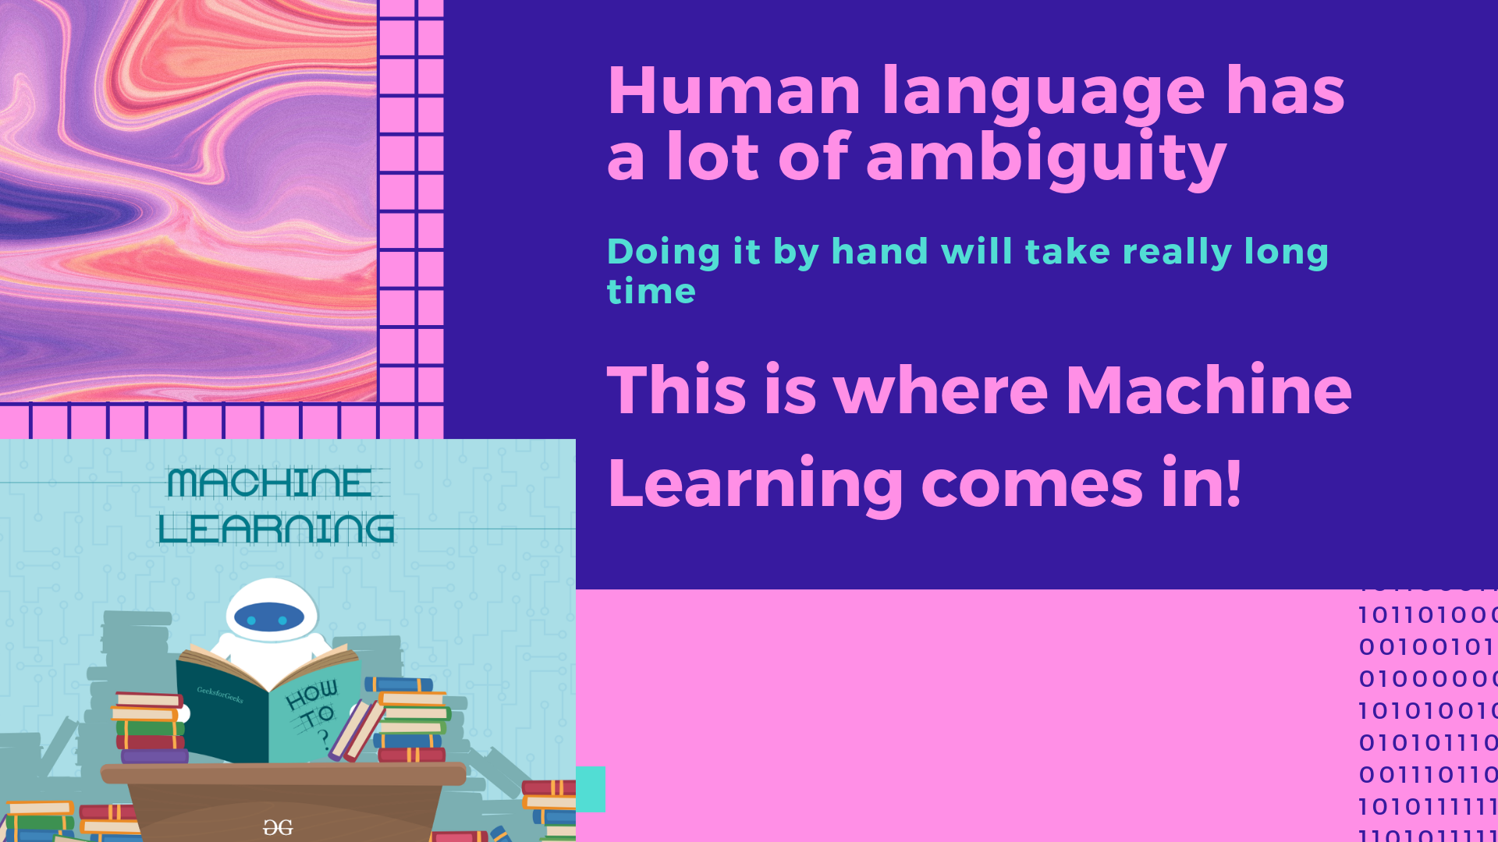

Slide 16
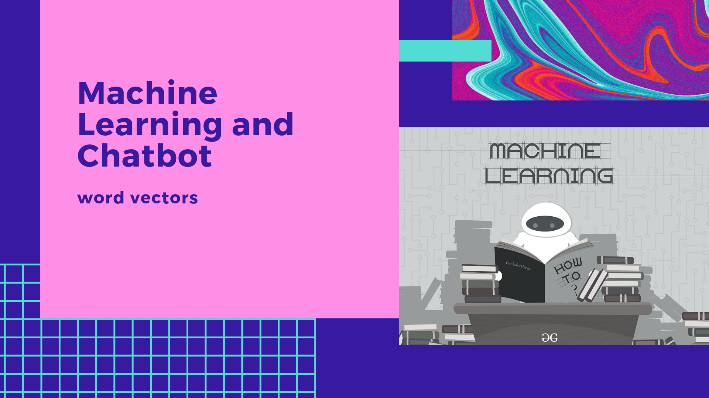

Slide 17
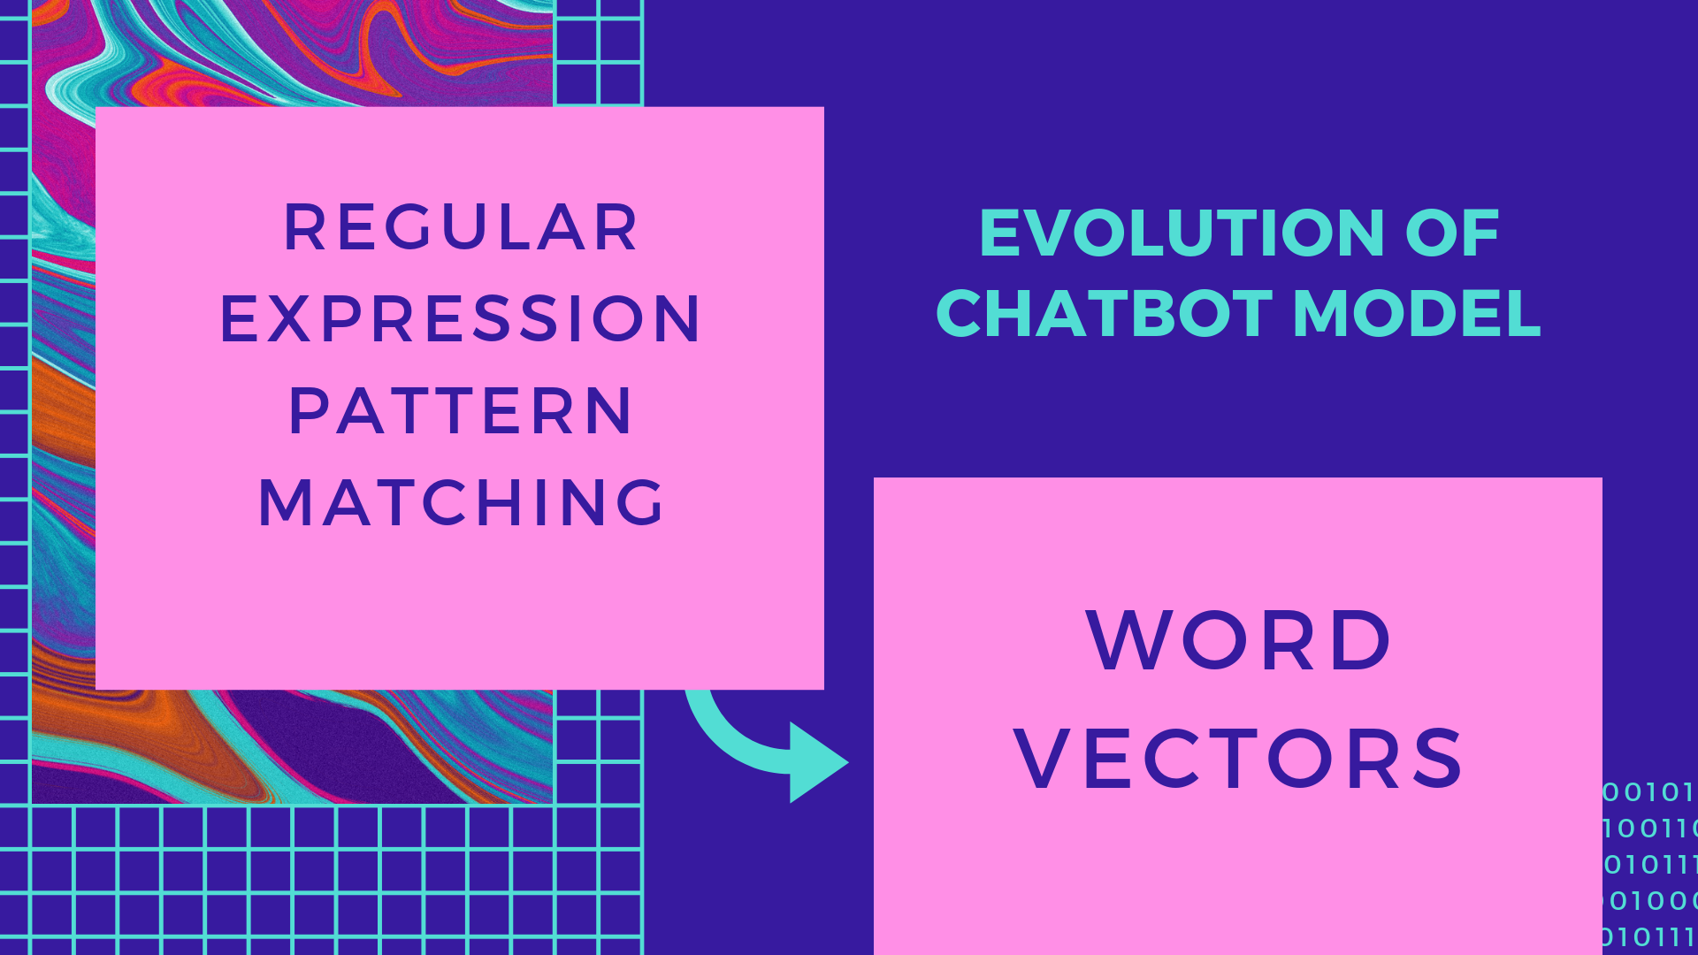

Slide 18
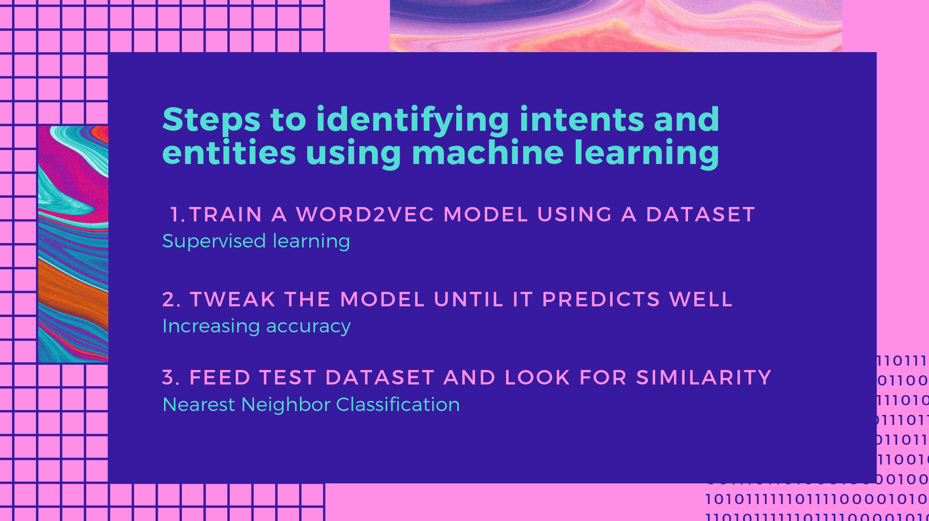
Notes:
Doing this from scratch takes a lot of data, time and computer power
Better idea is to use existing libraries with trained word vectors

Slide 19
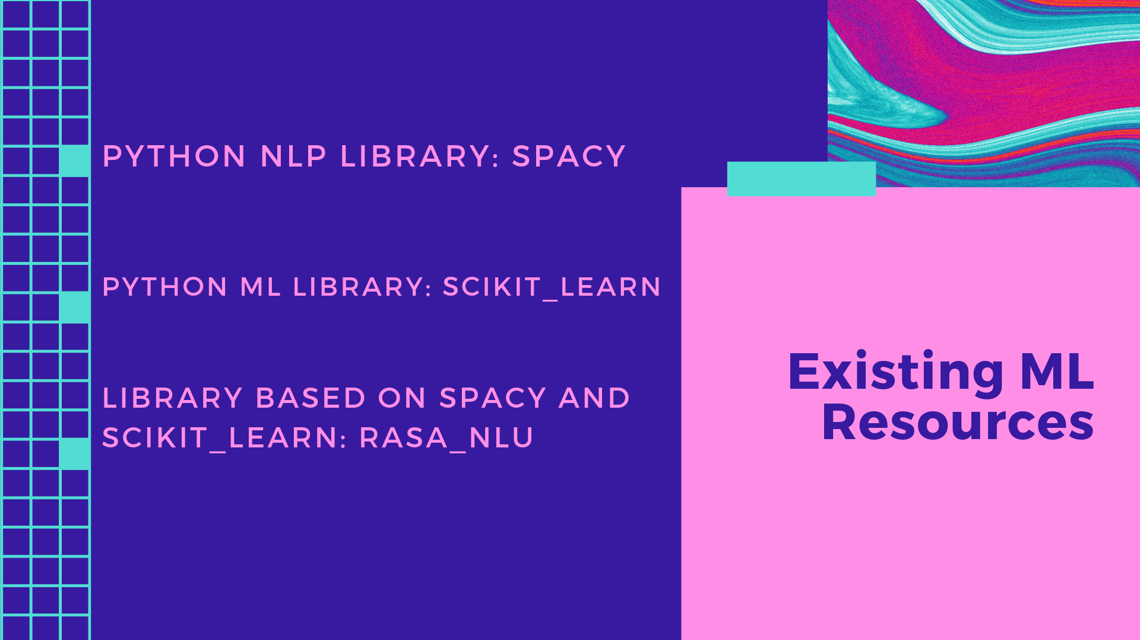
Notes:
I have linked to installing these libraries in the jupyter notebook in my github page.

Slide 20
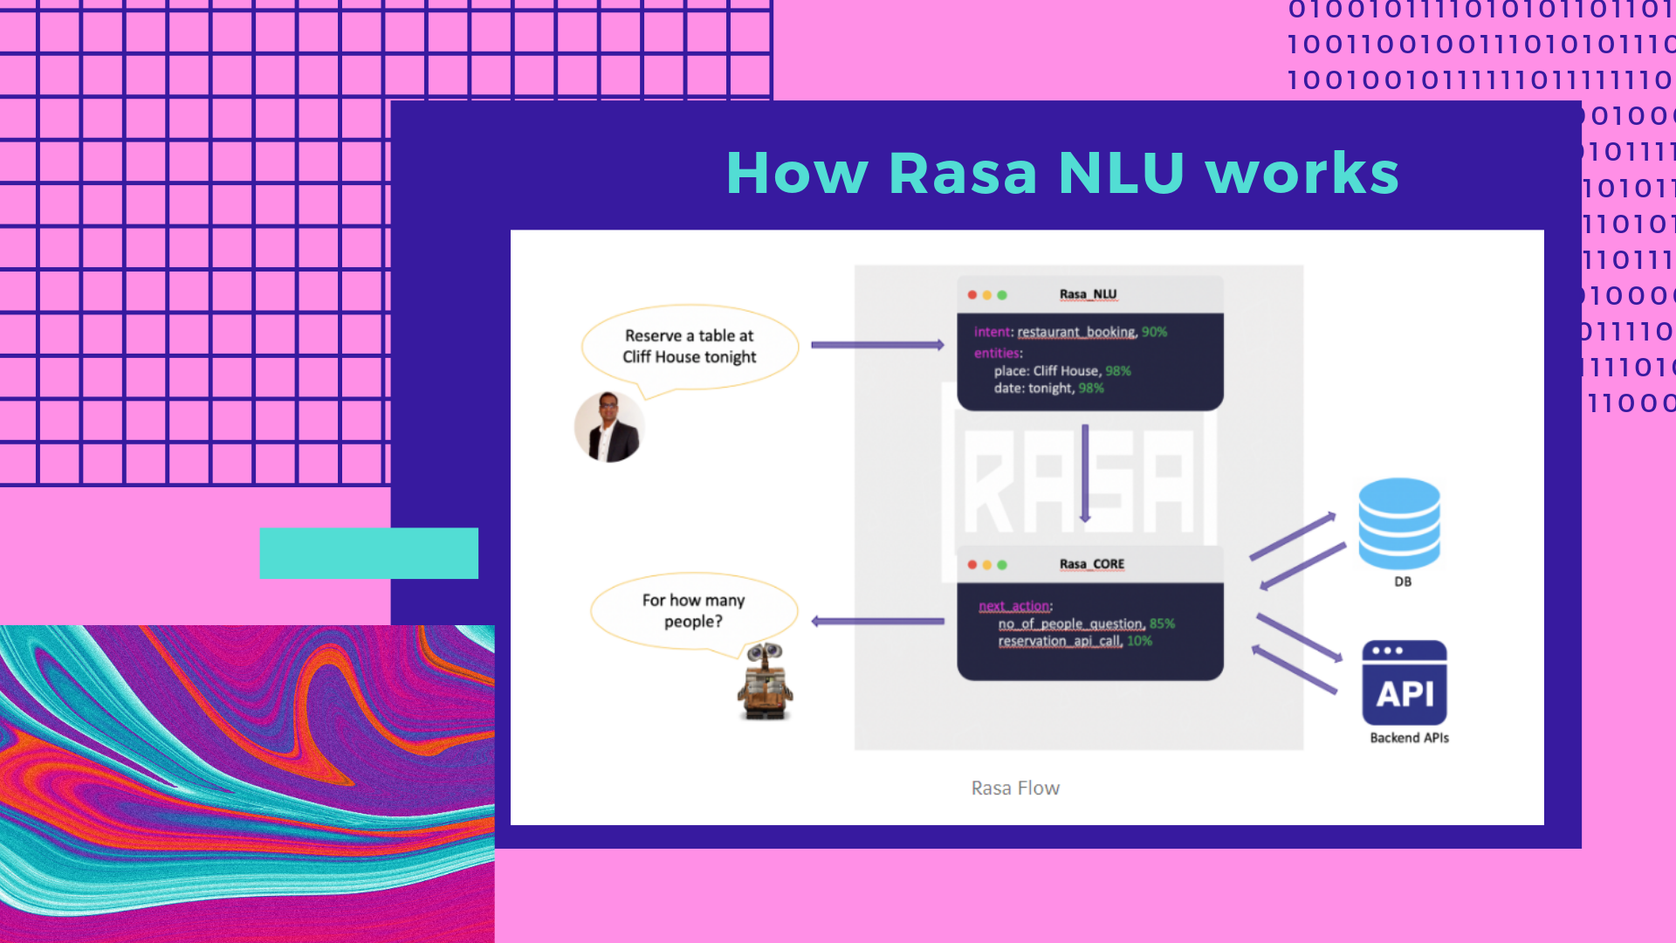
Notes:
Rasa core takes the structured input from the NLU and predicts the next best action using a probabilistic model

Slide 21
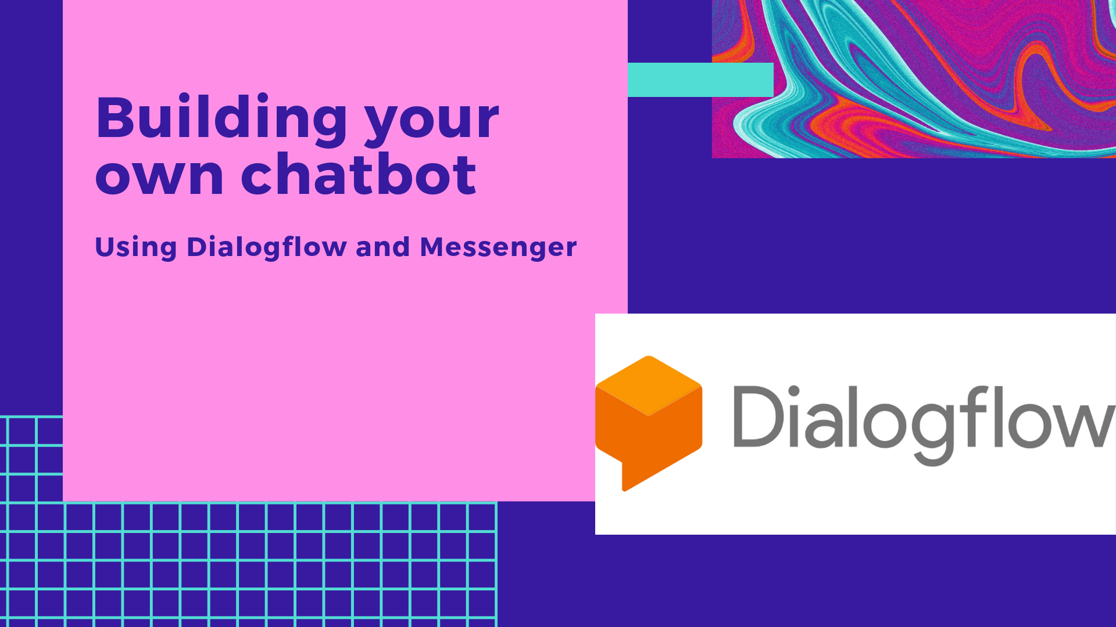
Notes:
Start the demo

